Slide 1
Project Modules
NEUROFORGE ENTERPRICE SDLC PLATFORM
PRESENTED BY :
Praveen Kumar Ramesh
july 29, 2026

Slide 2
Sprint Planning
DEVELOPMENT METHODOLOGY: AGILE
The NeuroForge Enterprise SDLC Platform will be developed using the Agile Software Development Methodology, which emphasizes iterative development, continuous collaboration, and frequent delivery of working software. Instead of building the entire system at once, the project is divided into 4 sprints, with each sprint lasting 2 weeks. At the end of every sprint, a functional module is completed, tested, reviewed, and improved based on stakeholder feedback.
Project Duration: 8 Weeks
Sprint Duration: 2 Weeks
Total Sprints: 4

Slide 3
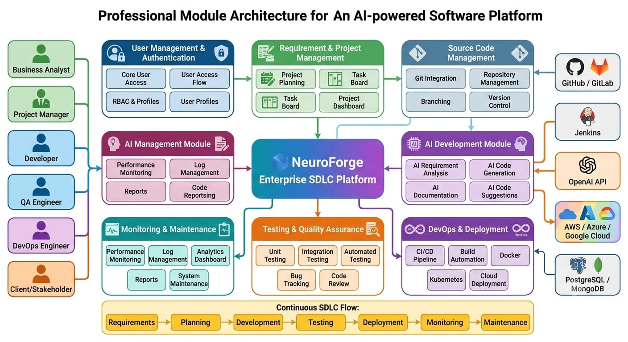
MODULE ARCHITECTURE

Slide 4
Sprint 1 (Weeks 1-2)
FOUNDATION & PROJECT MANAGEMENT
Objective
Build the foundation of the platform by implementing user management, authentication, and project planning capabilities.
Modules
  User Authentication & Login
  Role-Based Access Control (RBAC)
  User Management
  Requirement Management
  Project & Sprint Planning
Deliverables
  Secure user registration and login
  Different user roles (Admin, Manager, Developer, Tester, etc.)
  Project creation and configuration
  Requirement collection and management
  Sprint and task creation

Slide 5
Sprint 2 (Weeks 3-4)
DEVELOPMENT & COLLABORATION
Objective
Develop modules that improve collaboration and assist developers during software development.
Modules
  Task Assignment & Sprint Management
  AI-Powered Code Generation
  Documentation Management
  Git Integration & Version Control
  Team Collaboration
Deliverables
  Assign and track development tasks
  AI-assisted code generation
  Automatic technical documentation
  Git repository integration
  Team notifications and collaboration features

Slide 6
Sprint 3 (Weeks 5-6)
TESTING & DEVOPS
Objective
Implement quality assurance and DevOps capabilities to automate testing and software deployment.
Modules
  Automated Testing
  Bug Tracking
  Code Review
  CI/CD Pipeline
  Deployment Module
Deliverables
  Automated unit and integration testing
  Bug reporting and issue management
  AI-assisted code quality analysis
  Continuous Integration and Continuous Deployment
  Automated software deployment

Slide 7
Sprint 4 (Weeks 7-8)
MONITORING, ANALYTICS & FINAL DEPLOYMENT
Objective
Complete the platform by implementing monitoring, analytics, reporting, and maintenance features before final deployment.
Modules
  Real-Time Dashboard
  Performance Monitoring
  Reporting & Analytics
  Maintenance Module
  Final System Integration
Deliverables
  Live project monitoring dashboard
  Performance and resource monitoring
  Project and productivity reports
  System maintenance and update support
  Final integration, User Acceptance Testing (UAT), and production deployment

Slide 8
Thank you!

